Slide 1
Scaling Deep Learning on GPU and Knights Landing Clusters
Xiaotian Dou
University of Pittsburgh

Slide 2
Outline
Introduction
Background
Related Work
Experimental Setup
Distributed Algorithm Design
Algorithm Architecture Design
Result and Discussion

Slide 3
Introduction
Deep Learning Applications require large computing power
Current solutions like GPGPUs or FPGA need to fetch data from either CPU memory or remote processors at runtime, we use multi-GPU platform and Intel Knights Landing cluster(self-host chip) as target platform.
Algorithm side, we improved the Elastic Averaging SGD(EASGD) method by redesigning four efficient distributed algorithms:
Async EASGD -> Async MEASGD -> Hogwild EASGD -> Sync EASGD

Slide 4
Background
Intel Knights Landing Architecture:
Self-hosted Platform: self-hosted by an operating system, no need for CPU
Better Memory: 384 GB
Configurable NUMA: Non-uniform memory access

Slide 5
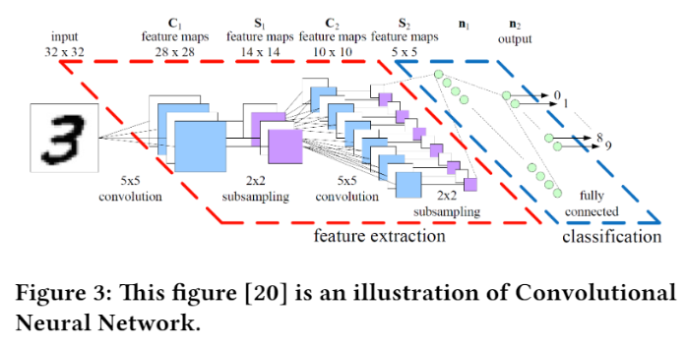
Convolutional Neural Networks

Slide 6

Stochastic Gradient Descent

Slide 7
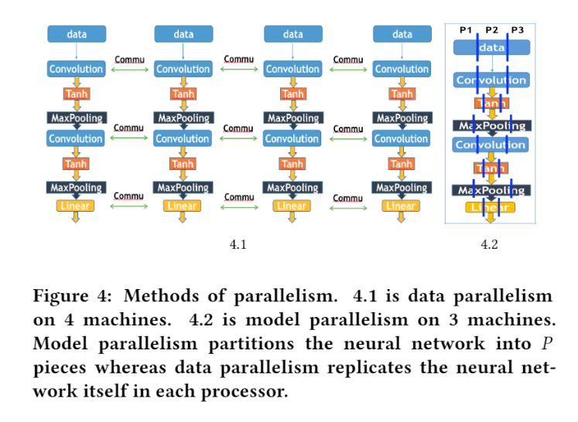
Data Parallelism and Model Parallelism

Slide 8
Related Work
Parameter Server
Hogwild
EASGD

Slide 9
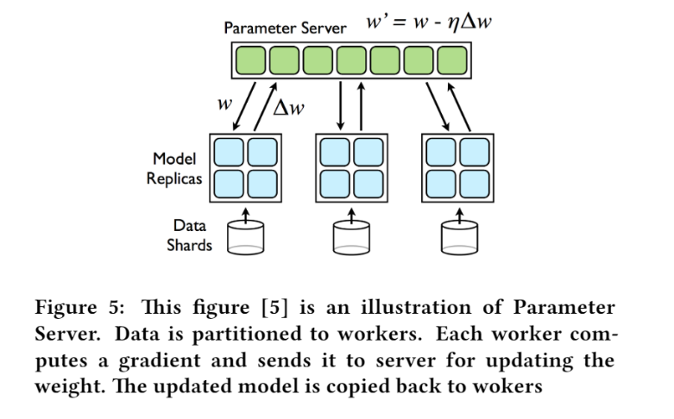
Parameter Server(Async SGD)

Slide 10
Hogwild (Lock Free)
Async SGD has a lock to avoid weight update conflict, make sure the master only processes one sub-gradient at a time.
The hogwild removes the lock and allows the master to process multiple sub-gradients at the same time.

Slide 11
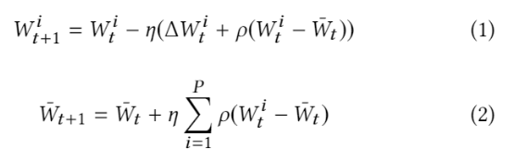
EASGD (Round-Robin)
Round-robin VS FCFS strategy
The master interact with one single worker at a time
Baseline

Slide 12
Distributed Algorithm Design

Slide 13
Async EASGD
Redesigning the parallel SGD methods
The computation and update of different GPUs are ordered, good fault-tolerance but inefficient.
To use parameter-server update to replace the round-robin update:
Use FCFS strategy to process multiple workers

Slide 14
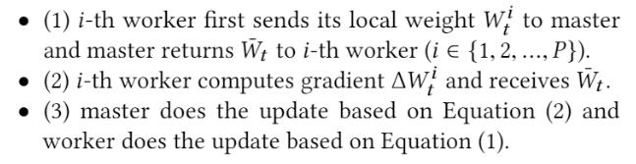
During the t-th iteration

Slide 15
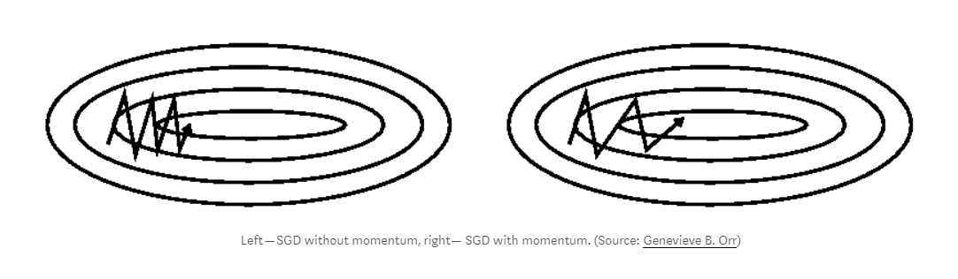
Async MEASGD
Add a momentum parameter V, help accelerate gradient in the right direction

Slide 16
Hogwild EASGD
Remove the lock for faster convergence

Slide 17
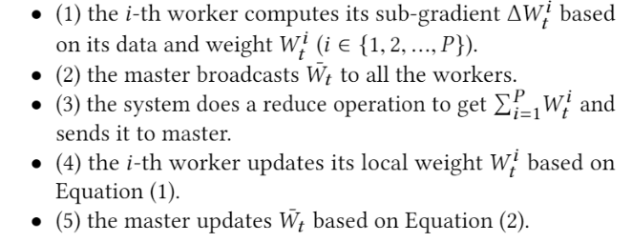
Sync EASGD

Slide 18
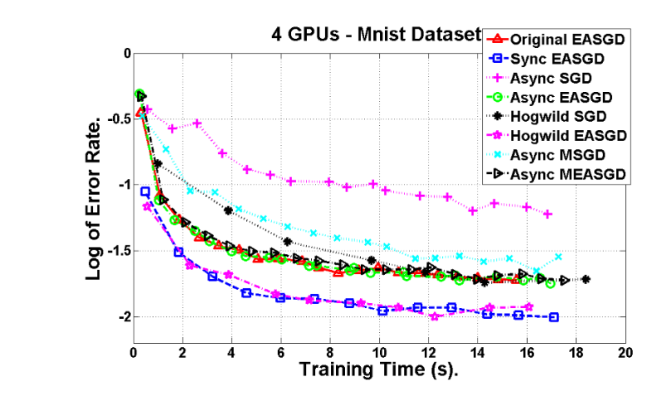
Overall Comparison

Slide 19
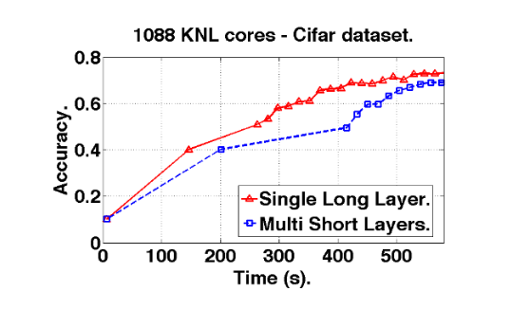
Single Layer Communication
Allocate the neural networks in a contiguous way and pack all the layers together and conduct one communication each time.

Slide 20
Multi-GPU Optimization
Sync EASGD1, there are 8 potentially time-consuming parts:
Data I/O ignore
Data and weight initialization ignore
GPU-GPU parameter communication communication
CPU-GPU data communication communication
CPU-GPU parameter communication communication
Forward and Backward propagation computation
GPU weight update computation
CPU weight update computation

Slide 21
CPU-GPU data communication is the key
Sync EASGD1: P blocking send/receive operations can be efficiently processed by a tree-reduction operation(standard MPI reduction)
Sync EASGD2: Put all training and test data on the CPU, put all weights on GPU to reduce communication overhead.
Sync EASGD3: overlap critical path 7-10 and 11-12

Slide 22
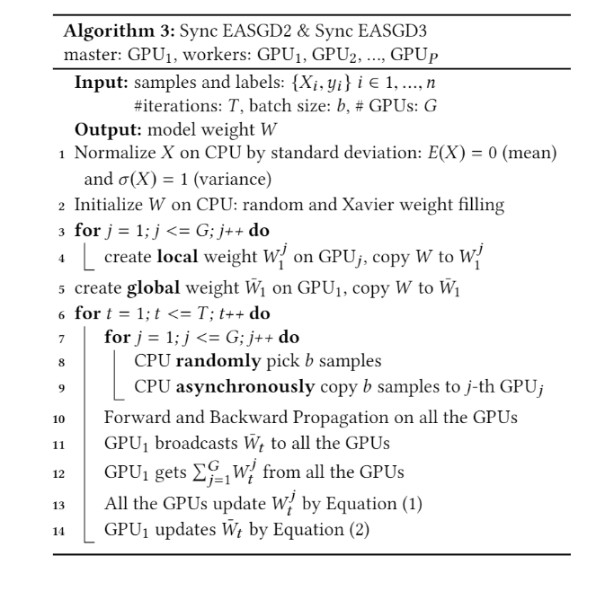

Slide 23
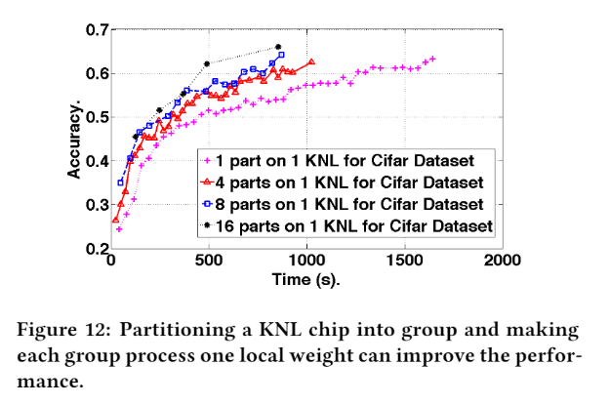
Knights Landing Optimization
68 cores or 72 cores, data locality, divide-and-conquer method:
Divide: replicating data and
Copying weights
Conquer: sum up the gradients
From all partitions

Slide 24
Thanks!

